Slide 1

More NP-Complete Problems and NP related classes
Instructor: Kuan Cheng

Slide 2
Topics
Independent set
Vertex cover
Integer programming
Hamiltonian path/cycle
Traveling salesman

Slide 3
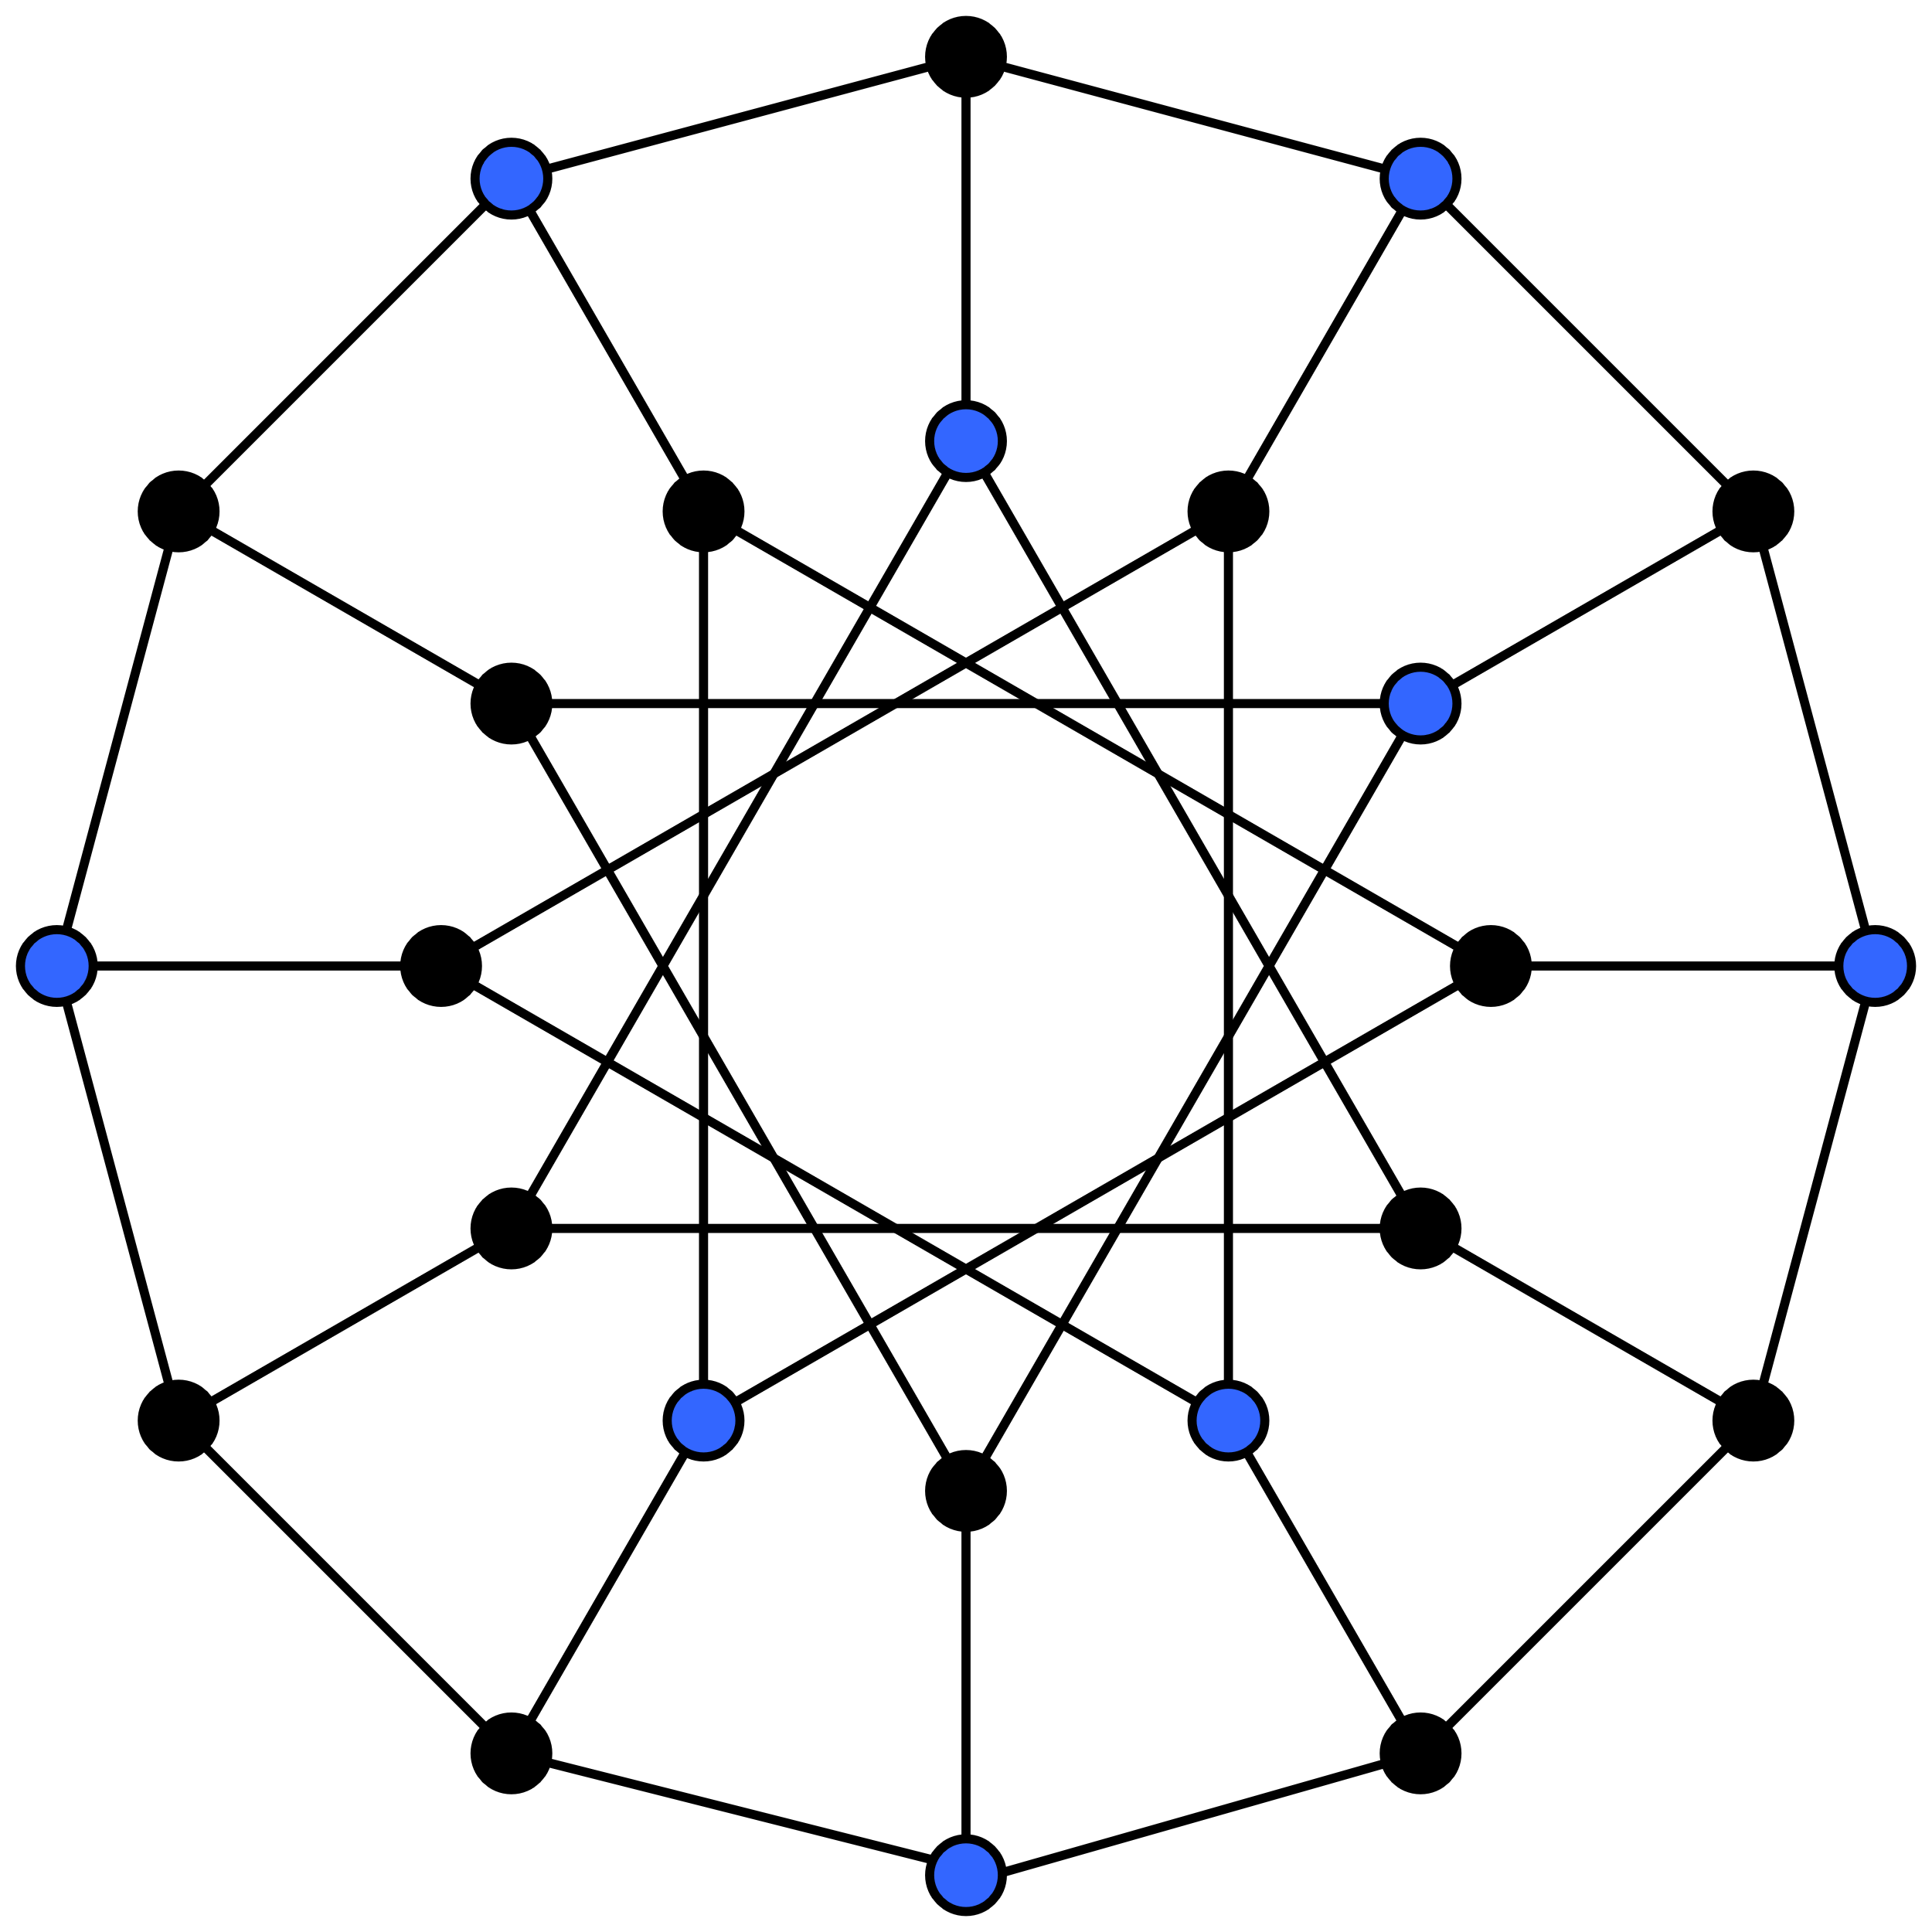
Independent set
Given a graph G and an integer k,
decide if G has an independent set of size k.
INDSET is NP-complete
Proof:
1) INDSET ∈ NP
2) Show 3SAT ≤p INDSET

Slide 4
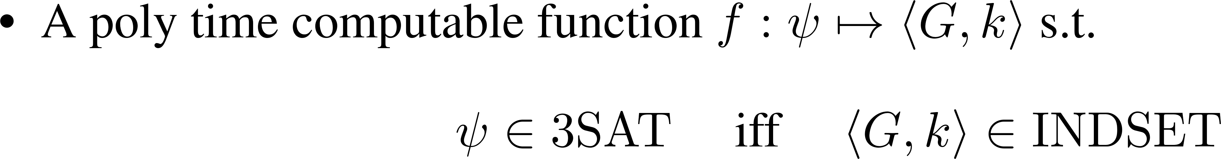
Reduction 3SAT ≤p INDSET

Slide 5
Reduction 3SAT ≤p INDSET

Slide 6

Reduction 3SAT ≤p INDSET

Slide 7
Vertex Cover

Slide 8

Reduction INDSET ≤p Vertex-Cover

Slide 9
Reduction INDSET ≤p Vertex-Cover
Key observation:
the complement of an independent set is a vertex cover, and vice versa.

Slide 10
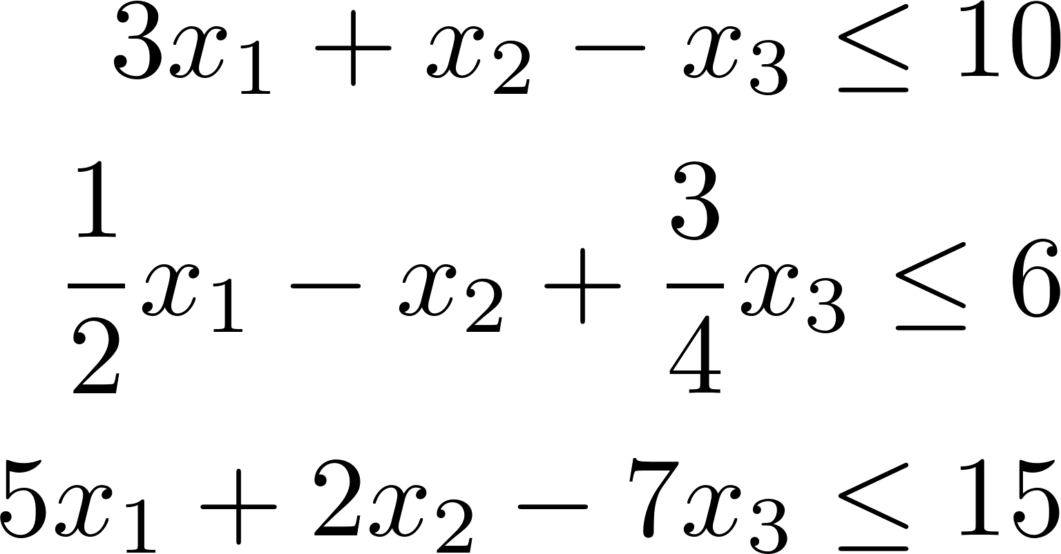
0/1 Integer Programming

Slide 11
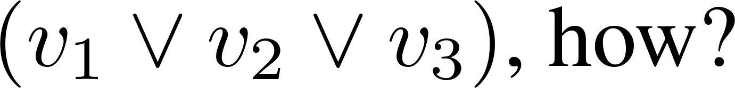
Reduction SAT ≤p IPROG

Slide 12
0/1 IPROG
Remark: if we relax the 0/1 assignment to rational assignment.
Then the problem can be solved by linear programming in polynomial time.

Slide 13
DSAT
Define DSAT={ the set of all satisfiable DNF formulas }
Clearly DSAT ∈ NP
Question: Is DSAT NP-complete?

Slide 14
Hamiltonian Path (directed)
A Hamiltonian path (H-path) in a directed graph is a path that visits all vertices exactly once.
dHAMPATH: given a directed graph, decide if it has a H-path.
Show dHAMPATH is NP-complete
Proof: 1) dHAMPATH ∈ NP 2) Show SAT ≤p dHAMPATH.

Slide 15
Reduction SAT ≤p dHAMPATH

Slide 16
Reduction SAT ≤p dHAMPATH

Slide 17
Reduction SAT ≤p dHAMPATH

Slide 18
Reduction SAT ≤p dHAMPATH

Slide 19
Reduction SAT ≤p dHAMPATH

Slide 20
Reduction SAT ≤p dHAMPATH

Slide 21
Hamiltonian Cycle (directed)

Slide 22
Reduction dHAMPATH ≤p dHAMCYCLE

Slide 23
Undirected Version

Slide 24
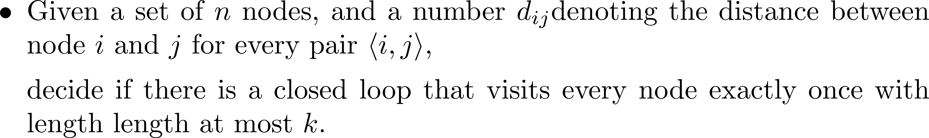
Traveling Salesman (TSP)

Slide 25
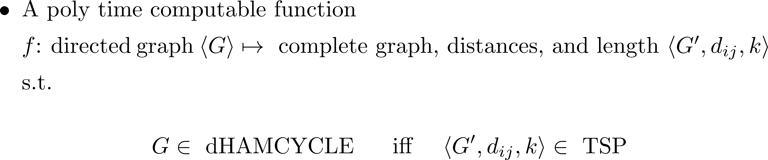
Reduction dHAMCYCLE ≤p TSP

Slide 26
Reduction dHAMCYCLE ≤p TSP

Slide 27
coNP
The class coNP
A language L ∈ coNP if its complement ¬ L ∈ NP.
coNP consists of all languages whose complement are in NP
Note: coNP is not the complement of NP!
In fact, P ⊆ NP ∩ coNP

Slide 28
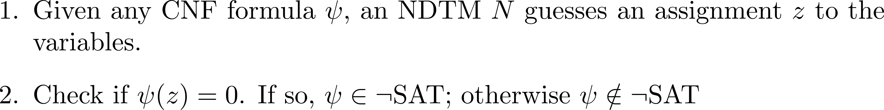
coNP

Slide 29
coNP Second Definition

Slide 30
CoNP-complete

Slide 31
coNP-complete

Slide 32
NEXP

Slide 33
NEXP
Theorem: If EXP ≠ NEXP, then P ≠ NP
Prove the contrapositive, i.e., if P=NP, then EXP = NEXP
Simple argument of padding

Slide 34
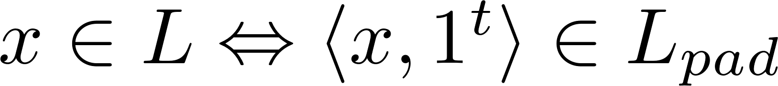
NEXP

